Slide 1

Software Development and Application Modeling​
Group 4 presentation
Notes:
Hello examiners and lecturer, we are group 4 of software development and application modelling. Today we will present to you our financial stock exchange system that we have developed.

Slide 2
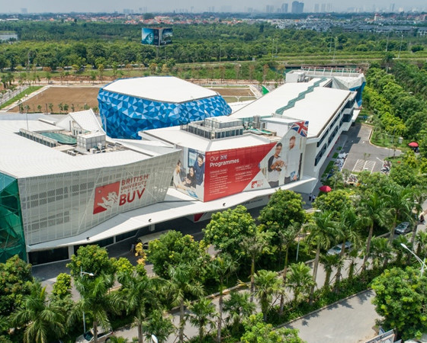
Group 4
Group members:
HAN20100042. Le Hoang Minh (Leader)​
HAN20090223. Nguyen Dang Hieu
HAN20090243. Le Quoc Vuong
HAN20090192. Nguyen Nhat Ha
HAN20100164. Duong Minh Long
Notes:
Our team has 5 members. I am Minh, the group leader, along with Hieu, Vuong, Ha and Long

Slide 3

Table of Contents:
1
2
3
Class Diagram
Use Case Diagram
Activity Diagram
4
5
6
Sequence Diagram
Analysis Diagram
Code result display
.
Notes:
Our presentation will begin with the design of our system, followed by code result demonstration. Each of us will present a diagram design, followed by the live program demonstration by me.

Slide 4
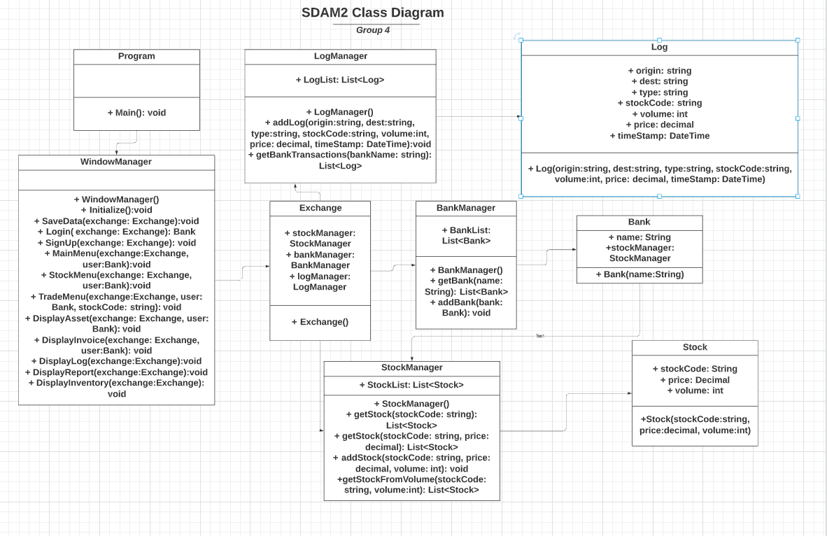
Class Diagram
Notes:
Our class diagram starts at Program class, which in turn initializes the class WindowManager that manages how the user interacts with the GUI and displaying different screens. It will generate function calls towards Exchange class, which has a Bank Manager, a stock manager and a log manager. A bank manager manages all banks registered with the exchange, a stock manager manages all stocks owned by the exchange, and the log manager keeps track of the exchange logs. Additionally, the bank also have a stock manager to manage its own stocks. Next is Hieu talking about our use case design

Slide 5
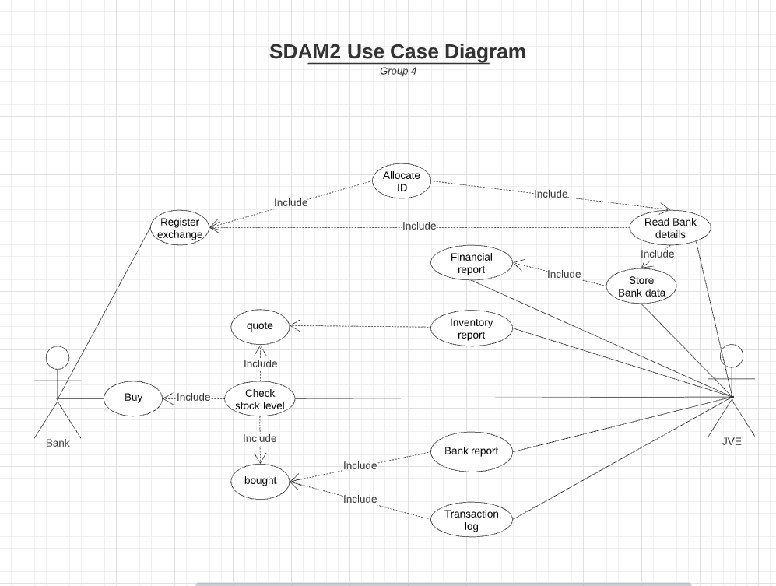
Use Case Diagram

Slide 6
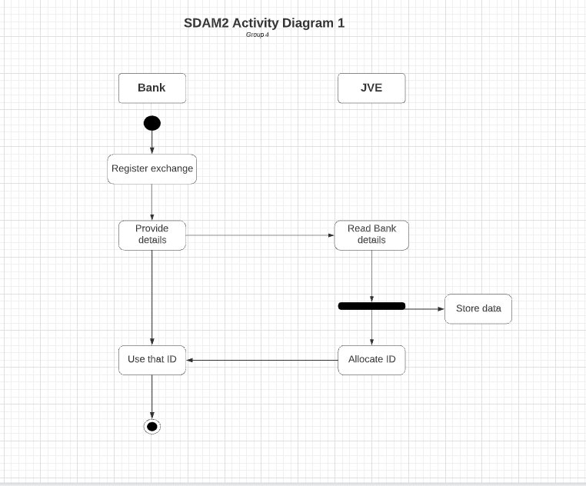
Activity Diagram 1

Slide 7
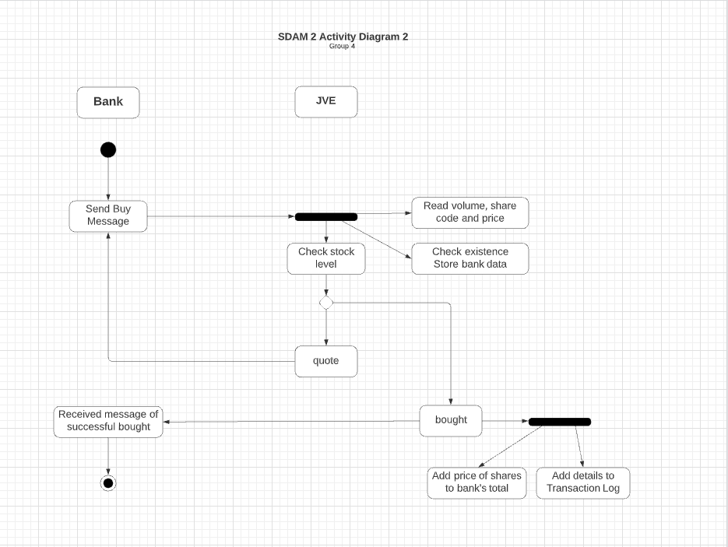
Activity Diagram 2

Slide 8
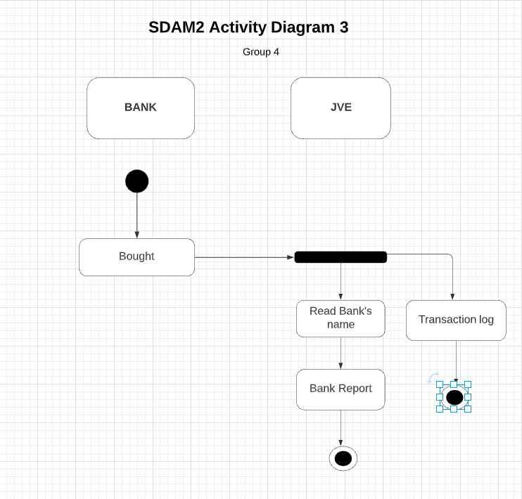
Activity Diagram 3

Slide 9
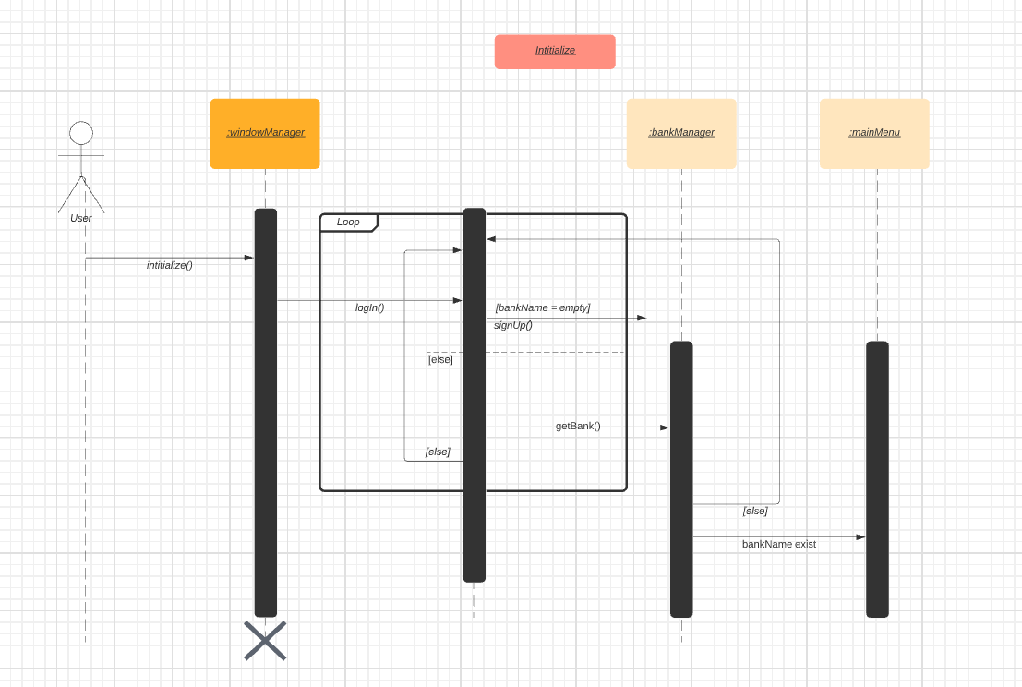
Sequence Diagram 1

Slide 10
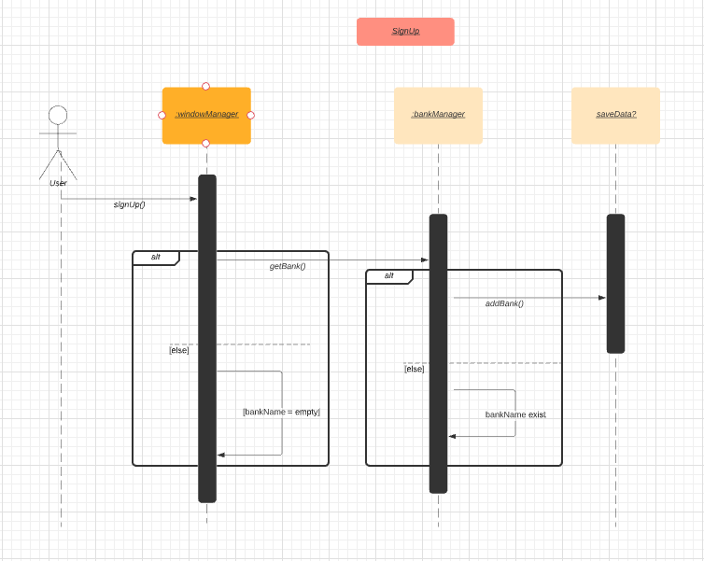
Sequence Diagram 2

Slide 11
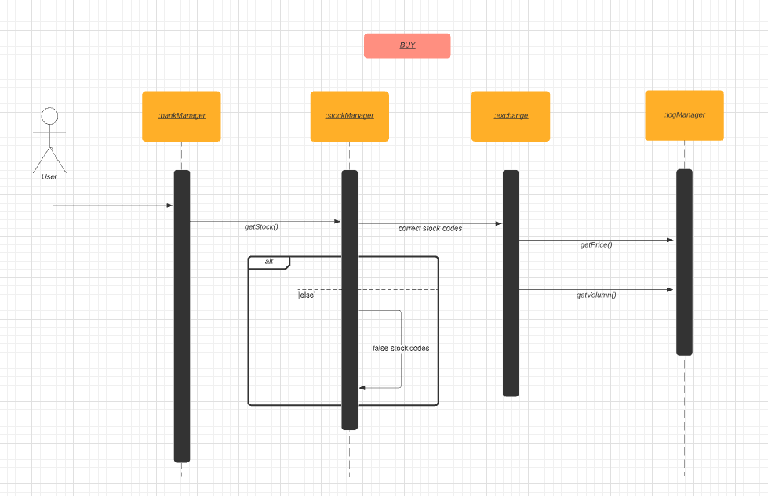
Sequence Diagram 3

Slide 12
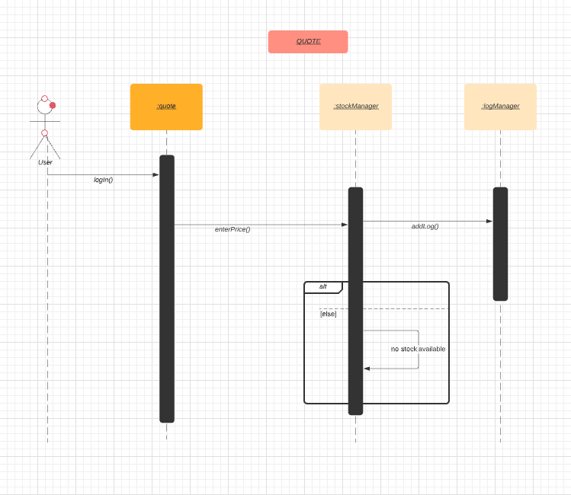
Sequence Diagram 4

Slide 13
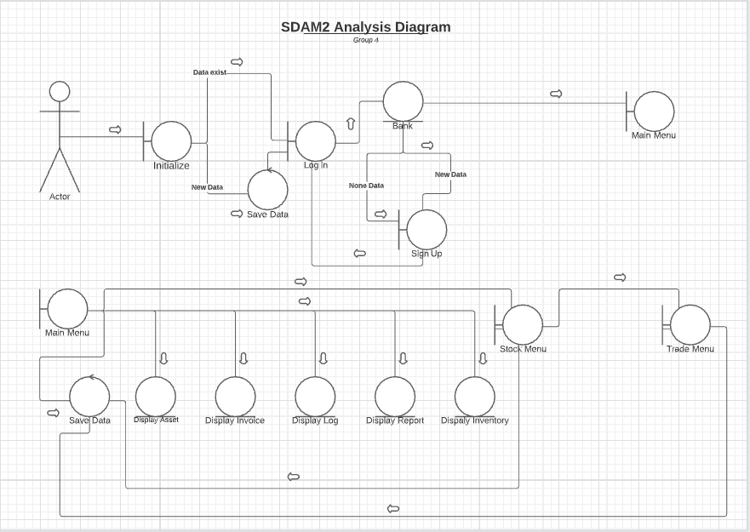
Analysis Diagram

Slide 14
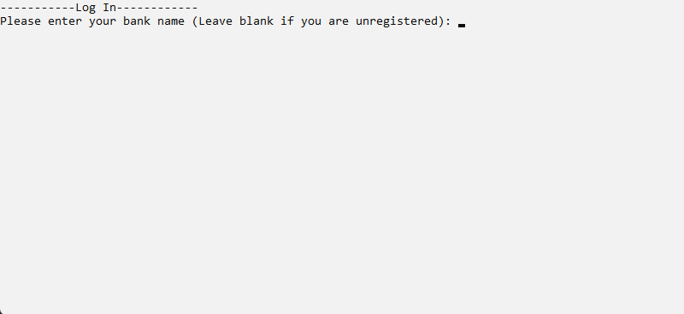
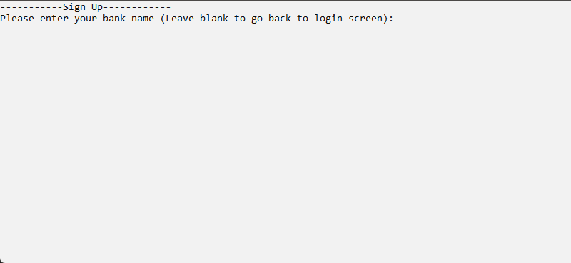
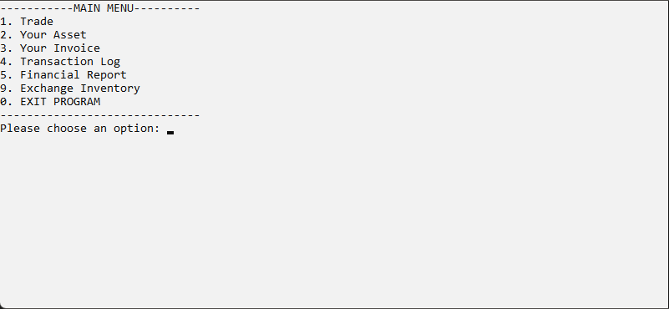
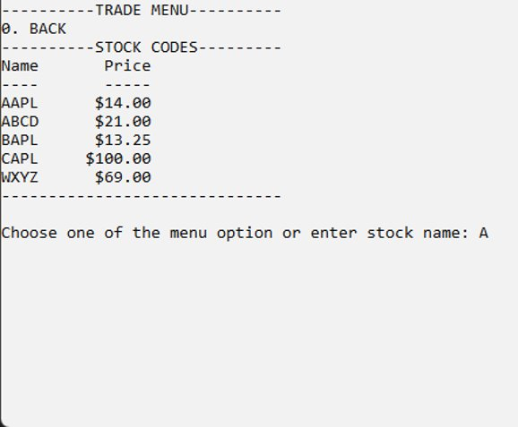

Slide 15
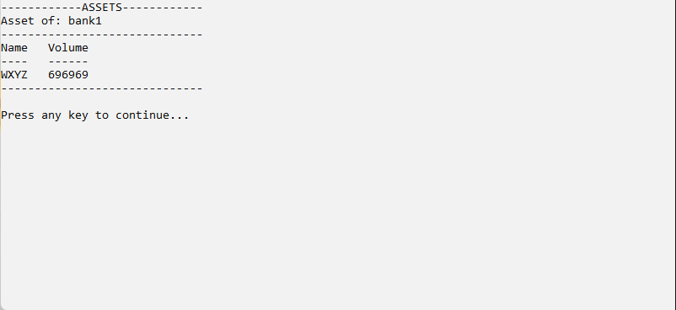
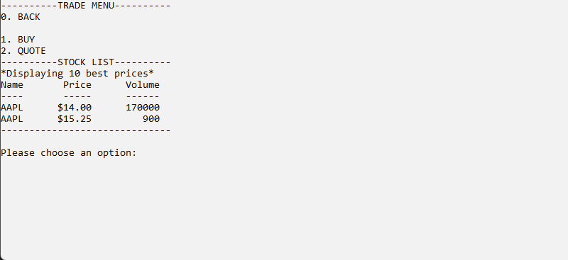
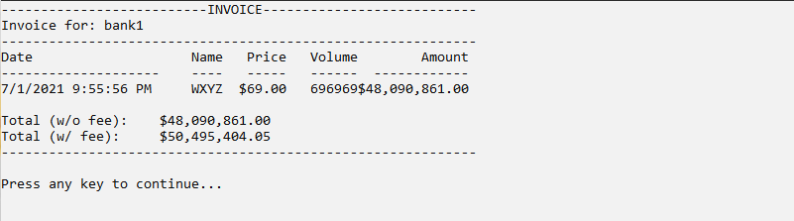

Slide 16
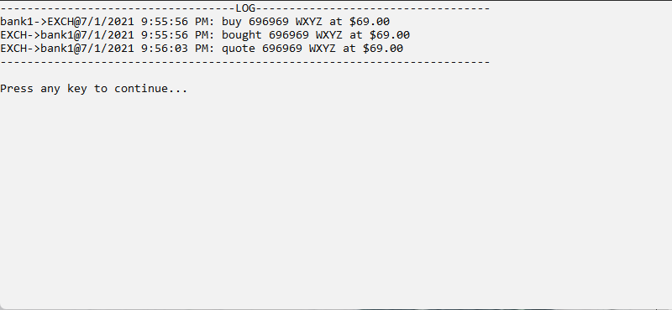
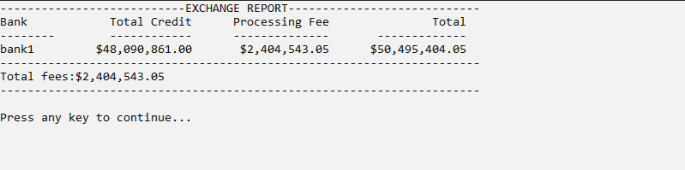

Slide 17
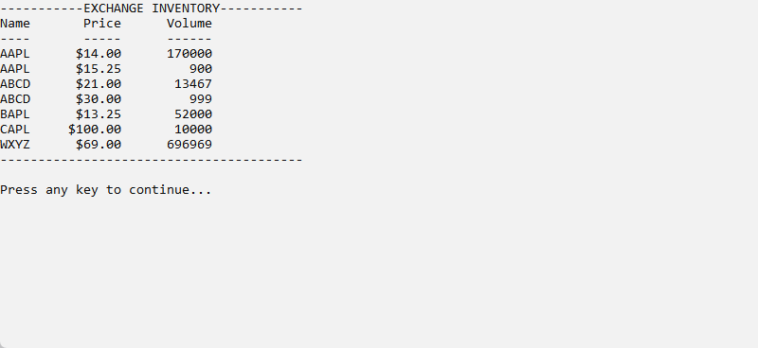

Slide 18

Thank you! And good luck!

